Slide 1
Back to School
In the COVID-19 Era
Webinar #1
July 10, 2020

Slide 2
A Full Plate for School Administrators
Prevent the Spread of COVID-19
How do you accomplish social distancing in a school?
Students, staff, and parents need to have CONFIDENCE
Facilities and custodial staff are going to be at the heart of building CONFIDENCE!

Slide 3
Webinar #2 Agenda
Re-Open Scenarios
CDC Guidance
Facility Disinfection Plan
How to Properly Disinfect
High Touch Disinfecting
Clean vs Disinfect
EPA List N

Slide 4
It’s About Making people feel safe
Students
Staff
Visitors
Parents

Slide 5
What’s the re-Open Plan
In Person
Hybrid
Distance Learning
CDC School Readiness & Planning Guide

Slide 6
Cleaning and Infection Control are a big part of the plan
CDC Guidance for Schools
Surfaces to be cleaned
Surfaces to be disinfected

Slide 7
Cleaning & Disinfecting
Develop Your Plan
Implement
Maintain and Revise
CDC Cleaning and Disinfection Decision Tool

Slide 8
The Role of Facilities maintenance and Custodians
Should I clean before I disinfect?
What about contact time?
How long is a surface protected?
Can disinfectants be used in a fogger
What disinfectants are approved for use against the human corona virus

Slide 9
How to Properly Disinfect
Cleaning and Disinfecting are different
Disinfectants have wet contact time
Wiping to dryness is cleaning
Leaving surfaces visibly moist is disinfecting

Slide 10
What’s your Plan?
Cleaning and Disinfecting is a key part of any school re-opening plan

Slide 11
1. Develop Your Plan
Select Disinfectants
What Needs to be Cleaned
What Needs to be Disinfected
Unoccupied spaces for 7+ days
do not need to be disinfected before
re-opening.
CDC Cleaning & Disinfecting Plan Guidance

Slide 12
2. Implement your Plan
Clean visibly dirty surfaces
Use the appropriate disinfectant
Follow directions on the label

Slide 13
3. Maintain and Revise As Needed
Continue and enhance routine cleaning
Revise practices specific to the type of business
Remove soft surfaces as much as possible
Consider removing frequently touched items
Maximize Fresh air intake
Minimize fans and blowers directed at people.

Slide 14
Disinfecting
What Needs Disinfecting
How Often
Using the Correct Process

Slide 15
Disinfecting Floor to Ceiling is NOT necessary
High Touch Disinfecting
Make your high touch checklist
Other surfaces can be cleaned
Disinfecting Properly
High Touch Checklists for Schools
Disinfecting Schedule

Slide 16
Approved Disinfectants for the Virus that causes COVID-19
EPA List N
2-Types of Disinfectants Listed
Emerging Viral Pathogen Claims
Claims for Human Corona Virus
Know the EPA registration #
EPA LIST N

Slide 17
Disinfectant Application Terminology
Fogging: Very small droplet size
Misting: Small droplet size
Spraying: Medium to Large Droplet Size
Trigger Spray: Targeted Spraying
Pump Sprayer: Targeted Spraying
Electronic Airless Sprayers: Wide Area Spraying
Electrostatic Sprayers: Targeted Spraying

Slide 18
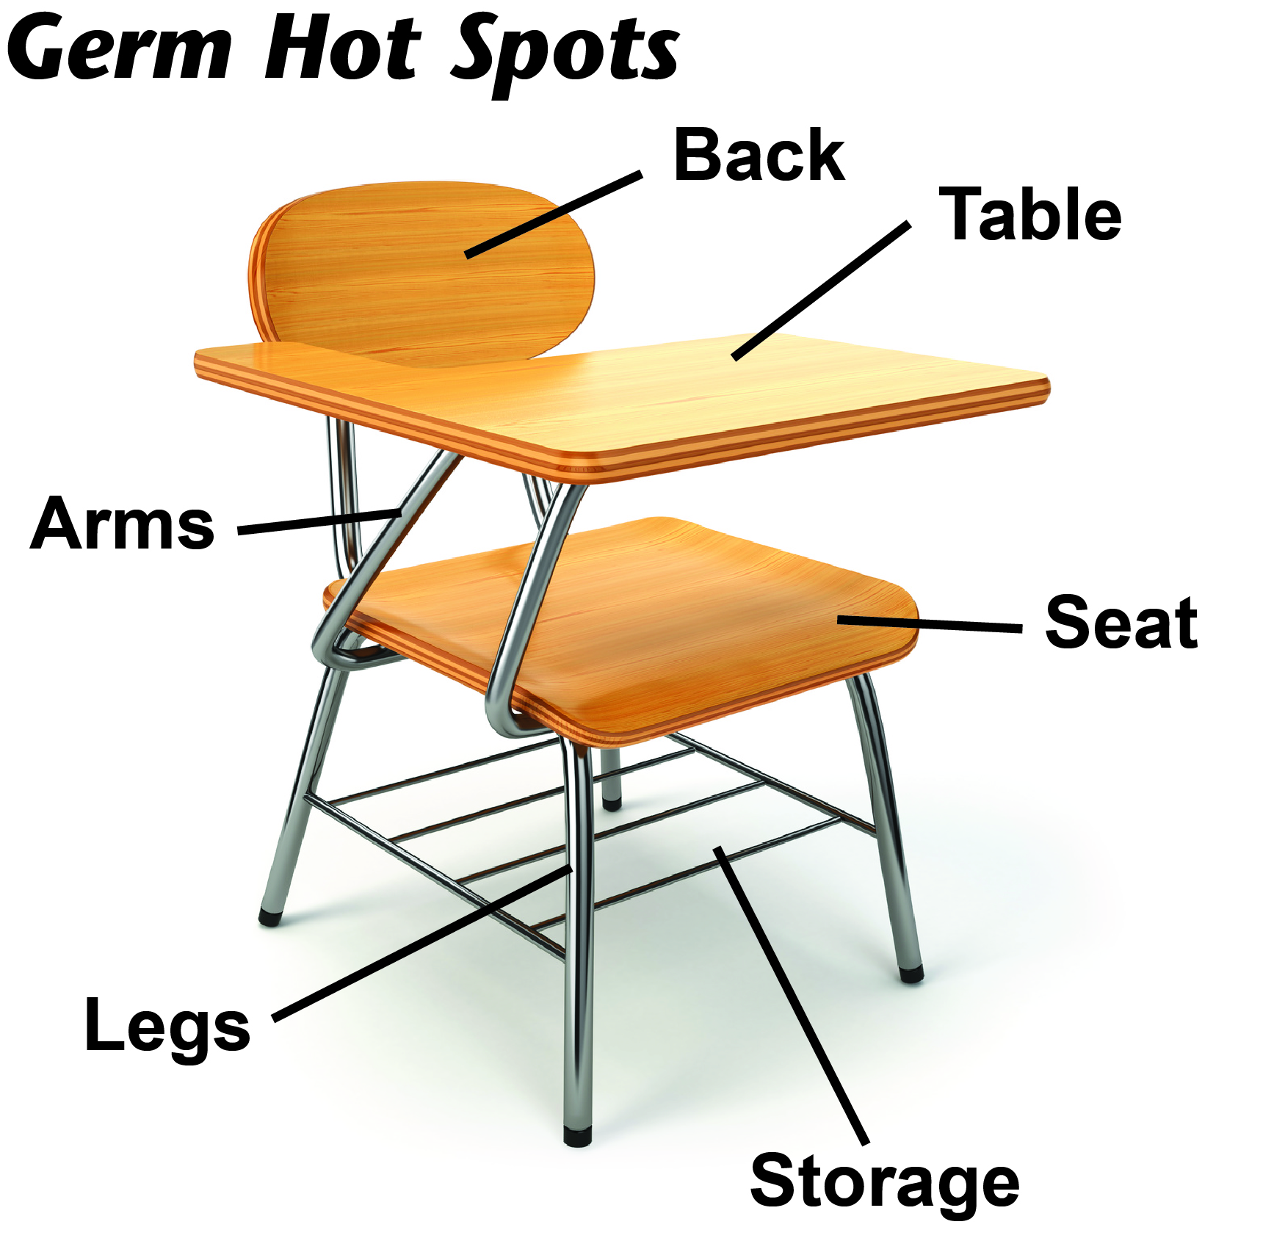
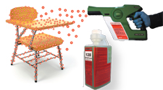
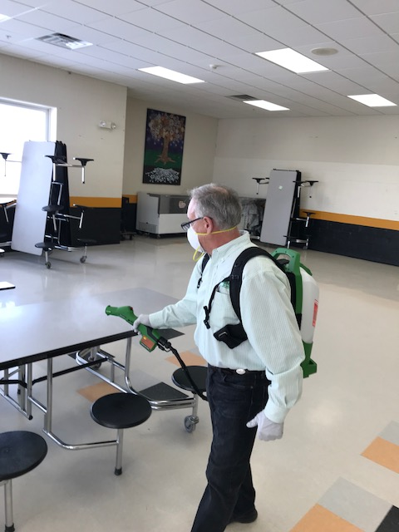
E-Spray
Electrostatic Sprayers

Slide 19
Thank you! Please visit our COVID-19 resources Page
TARVIN.M@MULTI-CLEAN.COM
WWW.MULTI-CLEAN.COM

