Slide 1
Open For Business
In the COVID-19 Era
Webinar #2
June 18, 2020

Slide 2
Webinar #2 Agenda
Facility Disinfection Plan
How to Properly Disinfect
High Touch Disinfecting
EPA List N
E-Spray Electrostatic Sprayers
What to look for in a disinfectant

Slide 3
It’s About Making people feel safe
Employees
Visitors
Customers
Students
Staff

Slide 4
FAQ’s
Should I clean before I disinfect?
What about contact time?
How long is a surface protected?
Can disinfectants be used in a fogger
What disinfectants are approved for use against the human corona virus
Disinfecting FAQ’s

Slide 5
How to Properly Disinfect
Cleaning and Disinfecting are different
Disinfectants have wet contact time
Wiping to dryness is cleaning
Leaving surfaces visibly moist is disinfecting

Slide 6
What’s your Plan?
Cleaning and Disinfecting is a key part of any business re-opening plan

Slide 7
Cleaning & Disinfecting
Develop Your Plan
Implement
Maintain and Revise
CDC Cleaning and Disinfection Decision Tool

Slide 8
1. Develop Your Plan
Select Disinfectants
What Needs to be Cleaned
What Needs to be Disinfected
Unoccupied spaces for 7+ days
do not need to be disinfected before
re-opening.
CDC Cleaning & Disinfecting Plan Guidance

Slide 9
Disinfecting Floor to Ceiling is NOT necessary
High Touch Disinfecting
Make your high touch checklist
Other surfaces can be cleaned
Disinfecting Properly
High Touch Disinfecting
High Touch Checklists-Industry Specific

Slide 10
2. Implement your Plan
Clean visibly dirty surfaces
Use the appropriate disinfectant
Follow directions on the label
CDC Cleaning & Disinfecting Plan Guidance

Slide 11
Approved Disinfectants for the Virus that causes COVID-19
EPA List N
2-Types of Disinfectants Listed
Emerging Viral Pathogen Claims
Claims for Human Corona Virus
Know the EPA registration #
EPA LIST N

Slide 12
Maintain and Revise As Needed
Continue and enhance routine cleaning
Revise practices specific to the type of business
Remove soft surfaces as much as possible
Consider removing frequently touched items
Maximize Fresh air intake
Minimize fans and blowers directed at people.

Slide 13
Disinfectant Application Terminology
Fogging: Very small droplet size
Misting: Small droplet size
Spraying: Medium to Large Droplet Size
Trigger Spray: Targeted Spraying
Pump Sprayer: Targeted Spraying
Electronic Airless Sprayers: Wide Area Spraying
Electrostatic Sprayers: Targeted Spraying

Slide 14
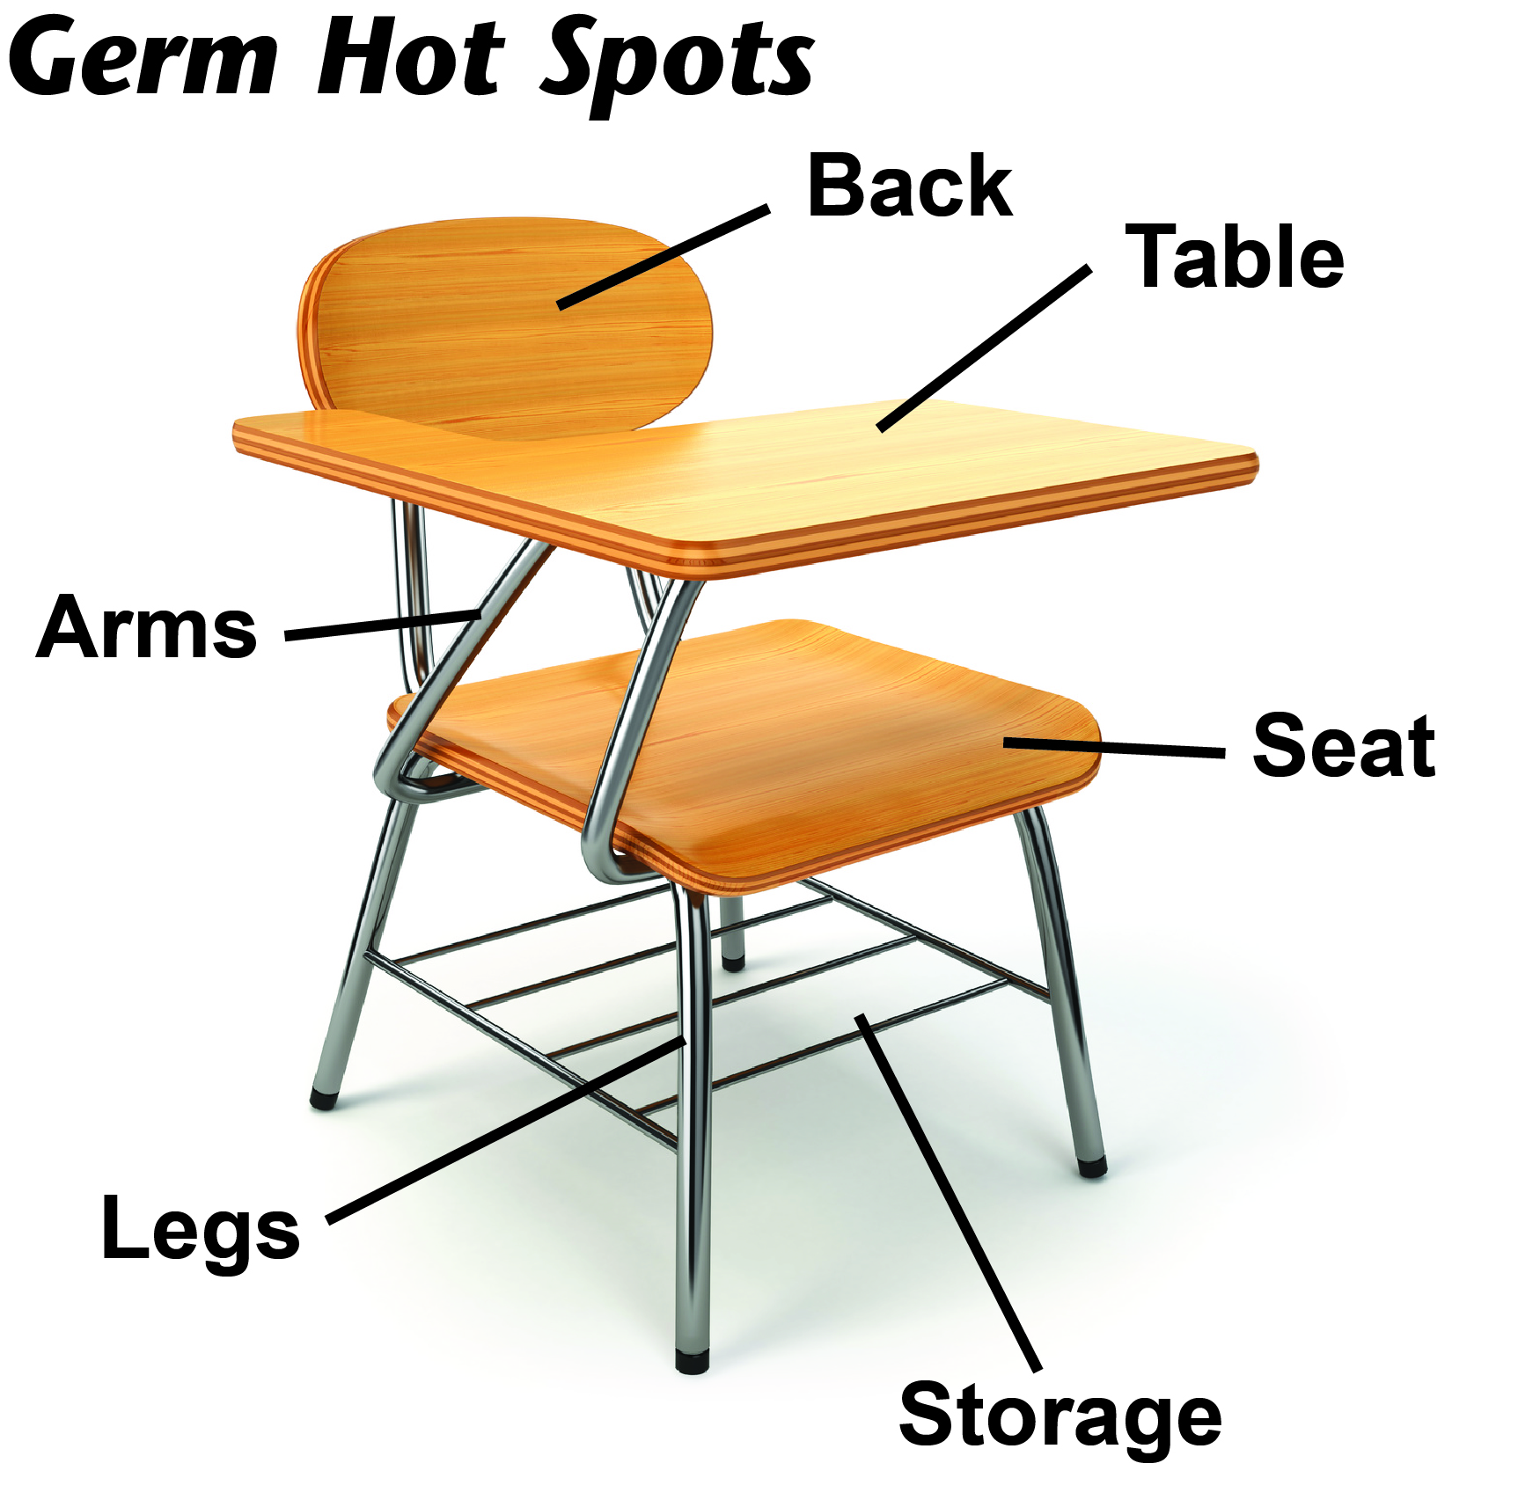
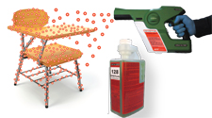
E-Spray
Electrostatic Sprayers

Slide 15
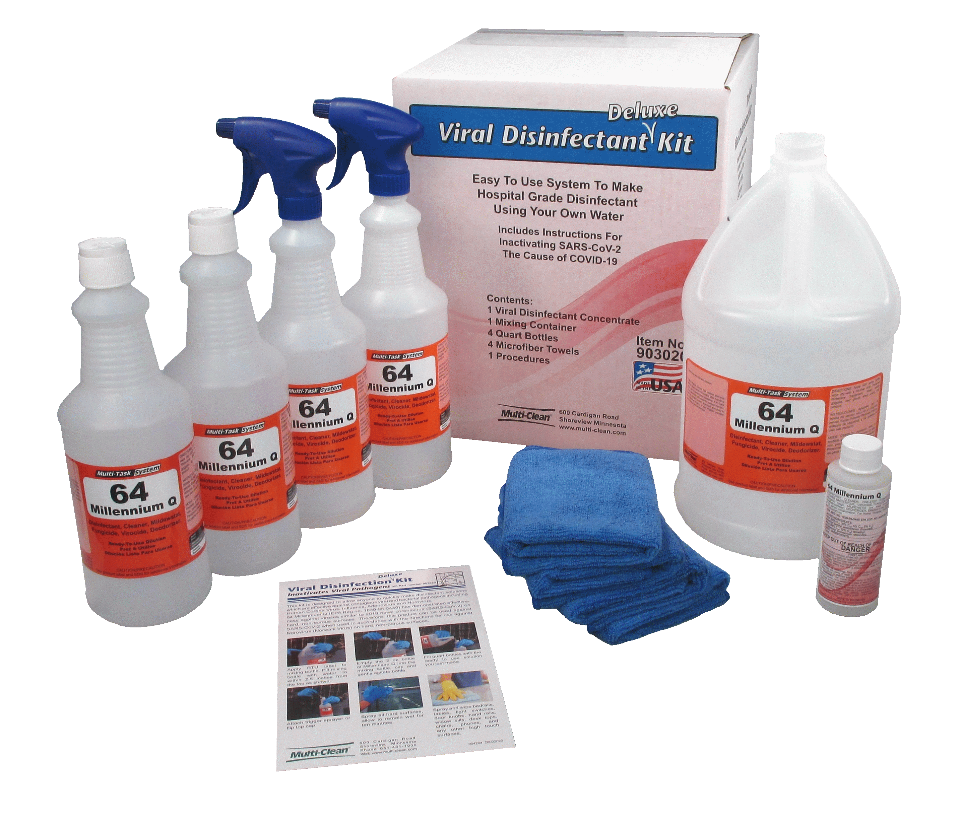
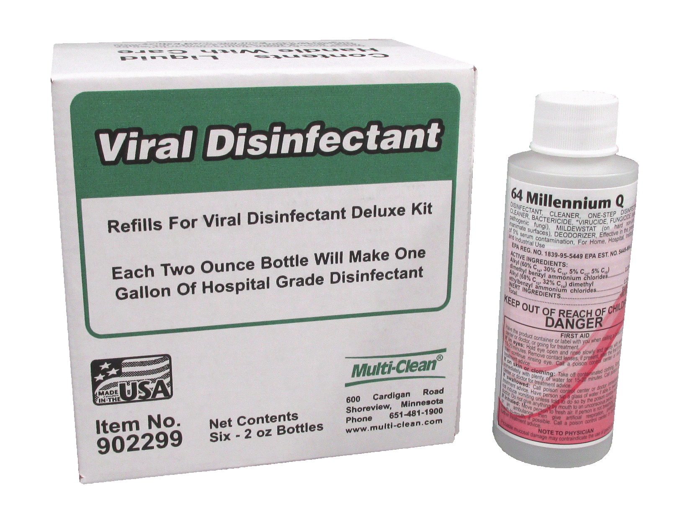
Viral Disinfection Kit
Makes 4 quarts using your own water
Light weight – only 2.5 lbs
Incl bottles, sprayers, microfiber, instructions
Great for the office share among 4 employees
Re-Fill kits available

Slide 16
Thank you! Please visit our COVID-19 resources Page
TARVIN.M@MULTI-CLEAN.COM
WWW.MULTI-CLEAN.COM

